Slide 1


Early Popularity Signals vs. Long Term Success in Movies
Team Members:
Prajwal Tejamurthy (A00050899)
Msc in Computing (Data Analytics)
prajwal.tejamurthy2@mail.dcu.ie
Aishwarya Shekar (A00050707)
Msc in Computing (Artificial Intelligence)
aishwaryashekar.shekar2@mail.dcu.ie
Khushi Natraj Bijkal (A00049400)
Msc in Computing (Data Analytics)
khushi.natrajbijkal2@mail.dcu.ie
Ashish Nagendrakumar (A00052416)
Msc in Computing (Artificial Intelligence)
ashish.nagendrakumar2@mail.dcu.ie

Slide 2
Predicting Long-Term Movie Success Using Machine Learning
Unpredictable
Movie Success
Machine
Learning Model
Predictable Movie
Success
Success is hard to
predict
Data-driven predictions
of movie success
Gather movie
production and
engagement data
Create relevant features
from data
Train a machine learning
model
Assess model
performance and
accuracy

Slide 3
Do early audience signals outperform production metadata?
Early Signals
Production Data
Outperform production metadata
Traditional focus
Focuses on audience behavior for insights
Relies on budget and genre
Audience engagement
Production features
New perspective on predicting success
Traditional focus for predictions

Slide 4
Project Objective :
Unpredictable
Movie Success
Data-Driven
Analysis
Data-Driven
Decisions
Factors driving success
are unclear
Key drivers of success
identified
Evaluate impact of
production elements
Assess influence of
audience engagement
Integrate both
production and
audience data

Slide 5
Data-Driven Approach to Movie Success
Use features to forecast
movie performance
Predict Success
Evaluate production vs.
audience features
Compare Features
Identify Drivers
Determine key factors
influencing success

Slide 6
Data Collection & Integration:
Ratings and vote
counts
User ratings and
activity
Budget, popularity,
release data
~36,000 movies
IMDb
MovieLens
TMDB
Final dataset
Combined multiple datasets for a comprehensive view
Captures both production and audience behaviour
Ensures better prediction accuracy
Final dataset includes ~36,000 movies

Slide 7
Data Preprocessing for Movie Success
Raw Movie Data
Data
Preprocessing
Clean Movie Data
Inaccurate and
unreliable modeling
Accurate and reliable
modeling
Remove invalid movie
entries
Impute or remove
missing data
Transform skewed data
for accuracy
Create new movie-
related features

Slide 8
Feature Engineering Process
Log of IMDb vote count
Target Variable
Budget, runtime, release
timing
Production Features
Ratings, rating count,
popularity
Audience Features
Categorical
Encoding
Converting categorical
data

Slide 9
Exploratory Data Analysis:
Skewed Vote
Distribution
Exploratory
Data Analysis
Data Pattern
Understanding
Few movies dominate
popularity
Justified
transformations for
better analysis
Apply log
transformation to data
Analyze vote distribution
with histogram
Examine correlation
between rating count
and success

Slide 10
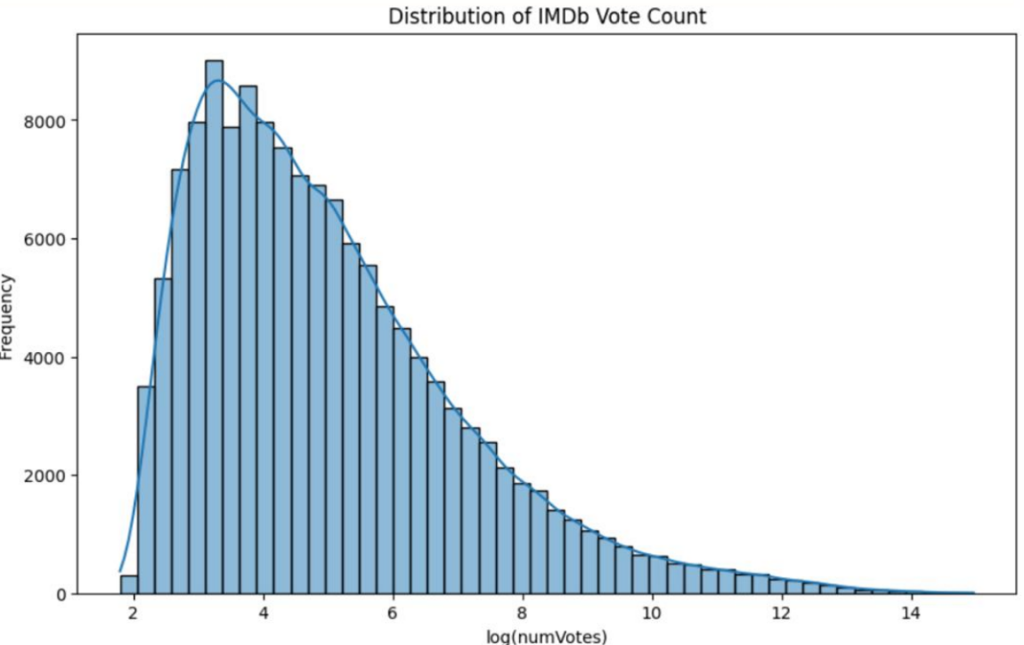
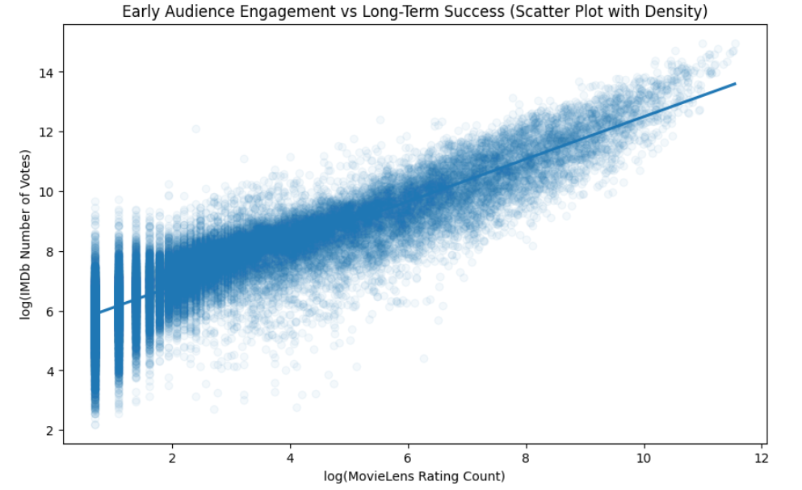
Understanding Data Patterns:
Fig-1. Popularity Distribution (IMDb Votes)
Fig-2. Early Engagement vs Long-Term Success
This above graph shows that most movies receive low engagement, while only a few movies become highly popular.
This above graph shows that movies with higher early engagement tend to achieve higher long-term success

Slide 11
Modelling Approach:
Production only,
Audience only,
Combined
Ensuring reliable
results
Simple and
advanced models
Models used:
Linear
Regression,
Random Forest
Compared 3
feature groups
Train-test split
(80/20)
Audience
model → R² ≈
0.80
Production
model → R² =
0.61
Combined
model → R² =
0.86
Improved
performance
Baseline
performance
Optimal
performance

Slide 12
Movie Success Prediction Pipeline
Data Merging
Feature
Selection
Combining data from
IMDb, MovieLens, and
TMDB
Choosing between
production and audience
features
Model
Evaluation
Model
Training
Assessing the model's
performance using metrics
Training the model using
selected features

Slide 13
Key Feature Importance:
82%
18%
MovieLens Rating Count
Other Features
Top predictor of success
Release year, ratings, runtime

Slide 14
Key Insights from Movie Success Prediction:
Early Audience
Engagement
User Behavior
Engagement Signals
Popularity vs
Production
Production Factors
Popularity
Key Insights
Accuracy
Combined Features
Reliability
Assumptions
Data-Driven
Decisions
Real Data

Slide 15

Conclusion:
Production Data
Combined Model
Production features
have some predictive
power but are less
effective than audience
signals.
A model that integrates
both audience and
production data
achieves the highest
accuracy.
Audience Signals
Early Popularity
Audience engagement
is a strong indicator of
movie success.
Early audience
engagement is crucial
for long-term success.
Movie Success
Prediction

Slide 16
Real-World Applications:
Early Prediction
Streaming
Platforms
Helps producers forecast
movie performance
Provides insights for Netflix
and IMDb
Practical Applications
Marketing
Strategies
Data-Driven
Decisions
Supports effective promotion
and release plans
Enables informed choices
based on analytics

Slide 17
Future Improvements:
Use Advanced
Models
Incorporate
Social Media
Data
Employ XGBoost and
Neural Networks for better
accuracy
Integrate social media
trends for richer insights
Develop Real-
Time
Prediction
Systems
Apply Time-
Series
Forecasting
Create systems for
immediate prediction
Use time-series analysis
for temporal patterns

Slide 18
Team Members Contribution:
The project was developed by working together as a team and sharing responsibilities among everyone.
Every team member took part in coding, designing the presentation, and writing the report, helping out at every step of the project.
We held regular team meetings and discussions to check our progress and make sure we were all on the same page with our decisions.
Each person looked over, confirmed and improved each other's work to make sure everything was consistent between the code, report and presentation.
The final results came from our teamwork, sharing knowledge and giving each other feedback, making sure everyone contributed equally.

Slide 19
[1] K. Lee, J. Park, I. Kim, and Y. Choi, "Predicting movie success with machine learning techniques: Ways to improve accuracy," Information Systems Frontiers, vol. 20, pp. 577–588, 2018, Available at
[2] M. T. Lash and K. Zhao, "Early predictions of movie success: The who, what, and when of profitability," J. Manage. Inf. Syst., vol. 33, no. 3, pp. 874–903, 2016 Available at
[3] A. Bhadrashetty and S. Patil, "Movie success and rating prediction using data mining," J. Sci. Res. Technol. (JSRT), vol. 2, no. 1, pp. 1–4, Jan. 2024 Available at
[4] V. R. Nithin, M. Pranav, P. B. Sarath Babu, and A. Lijiya, "Predicting movie success based on IMDB data," Int. J. Bus. Intell. (IJBI), vol. 3, no. 2, pp. 34–36, 2014 Available at
[5] M. Mestyán, T. Yasseri, and J. Kertész, "Early prediction of movie box office success based on Wikipedia activity big data," PLOS ONE, vol. 8, no. 8, p. e71226, 2013 Available at
[6] J. Liebig and A. Rao, "Predicting item popularity: Analyzing local clustering behavior of users," arXiv:1503.04404, 2015 Available at
[7] M. Agarwal, S. Venugopal, R. Kashyap, and R. Bharathi, "A comprehensive study on various statistical techniques for prediction of movie success," arXiv:2112.00395, Dec. 2021 Available at
[8] F. Fariha, K. I. Rushee, and M. F. S. K. Arnop, "Prediction of IMDb rating in Netflix shows using machine learning algorithms," in Proc. 3rd Int. Conf. Computing Advancements (ICCA), Dhaka, Bangladesh, Oct. 2024, pp. 754–761 Available at
[9] P. Dixit, S. Hussain, and G. Singh, "Predicting the IMDB rating by using EDA and machine learning algorithms," IJSRCSEIT, vol. 6, no. 4, pp. 441–446, Jul.–Aug. 2020 Available at
Research Papers:

Slide 20
[10] C. D. Butler, M. Akhter, E. Jackson, M. A. Rahman, and L. Chang, "Predicting movie success using machine learning algorithms," in Proc. 15th LACCEI Int. Multi-Conf. Eng., Educ., Technol., Boca Raton, FL, USA, Jul. 2017 Available at
[11] R. Sharda and D. Delen, "Predicting box-office success of motion pictures with neural networks," Expert Syst. Appl., vol. 30, no. 2, pp. 243–254, Feb. 2006 Available at
[12] K. R. Apala, M. Jose, S. Motnam, C.-C. Chan, K. J. Liszka, and F. de Gregorio, "Prediction of movies box office performance using social media," in Proc. 2013 IEEE/ACM Int. Conf. Advances Social Networks Anal. Mining (ASONAM), Niagara, ON, Canada, Aug. 2013, pp. 1209–1214 Available at
Thank you , Any Questions ??

